Slide 1
Obesity Classification
Group 5

Slide 2
Table of Contents
01
03
Introduction
Obesity Dataset
02
04
Classification model
Evaluation
05
Conclusion
Obesity by Country and Obesity Classification Dataset

Slide 3
01
Introduction

Slide 4
Introduction
The report analyzes global obesity trends from 1975 to 2016, highlighting Vietnam's situation.
It utilizes a computer model based on obesity data to analyze patterns specifically among teachers, aiming to understand the prevalence and causes of obesity within this group.
The goal is to identify effective strategies for promoting healthier lifestyles and preventing obesity-related health issues, particularly in educational settings.

Slide 5
02
Obesity Dataset
Obesity by Country and Obesity Classification Dataset

Slide 6
Obesity by Country Dataset
Prepocessing:
Loaded and cleaned data by removing non-informative rows and organizing it with headers for Year, Gender, and Country, covering 195 countries from 1975 to 2016.
Extracted key numeric information (percentage of obesity and its confidence interval) from the dataset for analysis.
Ensured the dataset had no missing values, excluding data-lacking countries like Monaco, San Marino, South Africa, and Sudan.

Slide 7
Obesity by Country Dataset
Filter the Dataset:
Finalized dataset includes data from 191 countries, categorized by Gender (Male, Female, Both Sexes) and Continent (Asia, America, Europe, Africa, Oceania), excluding Antarctica.
Split the original dataset into three subsets based on gender to facilitate the analysis of obesity trends among different genders from 1975 to 2016.
Created a dedicated dataset for Vietnam to focus on obesity trends within a local context, enhancing relevance and applicability of the findings.

Slide 8
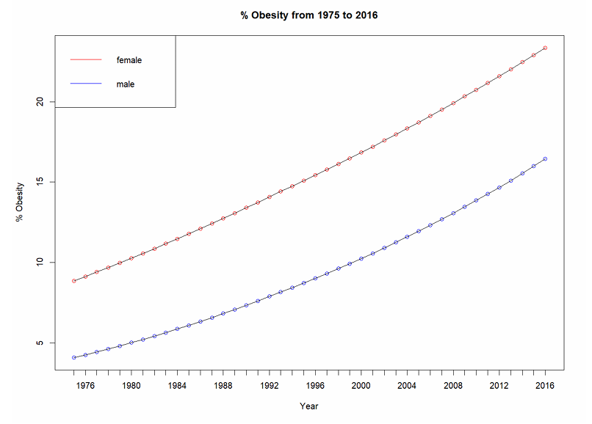
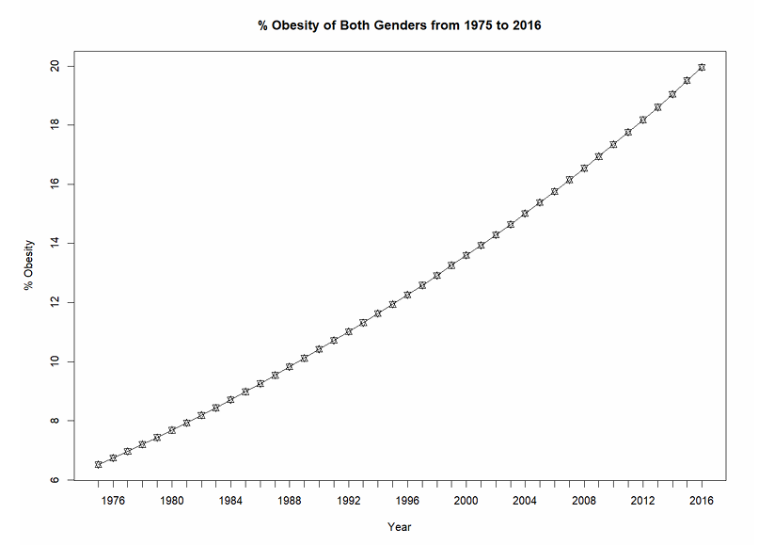
Obesity by Country Dataset
Data Analysis:
Obesity Trend of Females and Males from 1975 to 2016 Worldwide
Obesity Trends of Both Sexes from 1975 to 2016 Worldwide

Slide 9
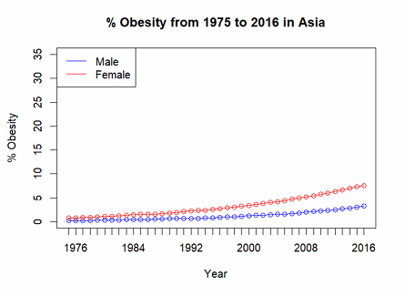
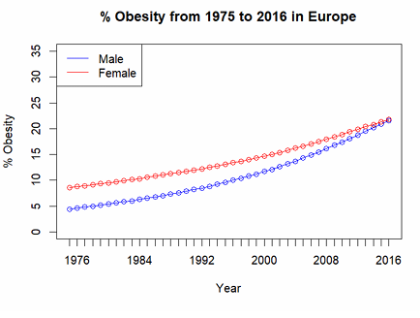
Obesity by Country Dataset
Data Analysis:
Obesity Trend of Females and Males from 1975 to 2016 Divided by Continents

Slide 10
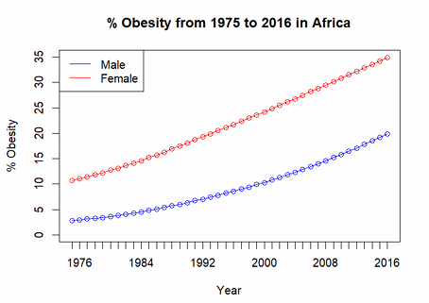
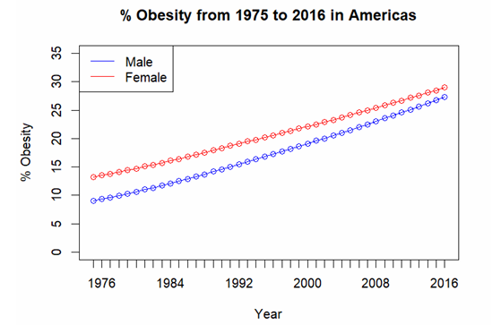
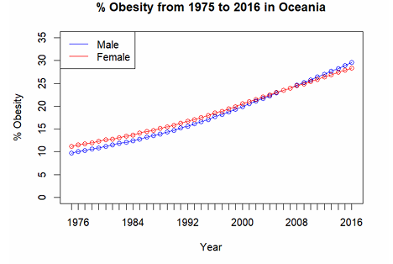
Obesity by Country Dataset
Data Analysis:
Obesity Trend of Females and Males from 1975 to 2016 Divided by Continents

Slide 11
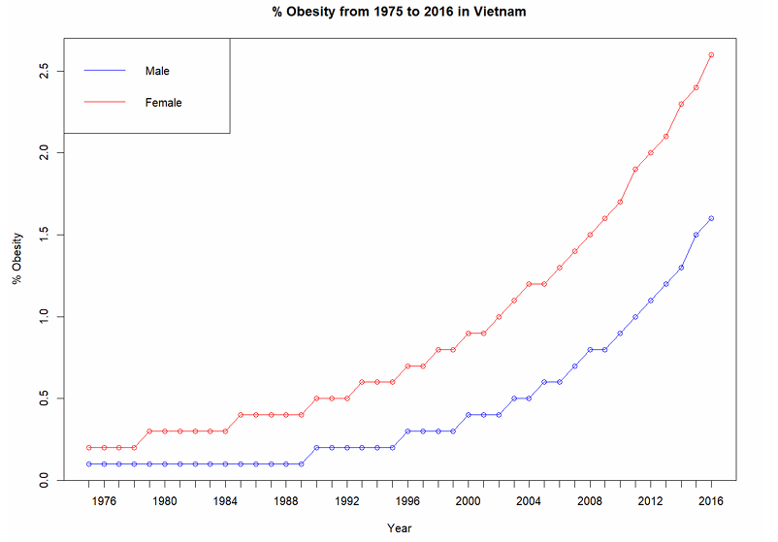
Obesity by Country Dataset
Data Analysis:
Obesity Trend of Females and Males from 1975 to 2016 Divided in Vietnam

Slide 12
Obesity Classification Dataset
Data Observations:
- The dataset includes 1,000 entries across 7 columns (Age, Gender, Height, Weight, BMI, Physical Activity Level, Obesity Category) with detailed demographic and obesity-related information, with ages ranging from 18 to 79 years.
- Statistical analysis reveals varied distributions: average age of ~49.86 years, height from 136.12 to 201.42 cm, weight from 26.07 to 118.91 kg, and BMI from 8.47 to 50.79, indicating a diverse range of body types and obesity classifications.
- Gender distribution is nearly balanced with 523 males (52.3%) and 477 females (47.7%), and obesity category distribution shows 371 normal weight, 295 overweight, 191 obese, and 143 underweight individuals, highlighting varied obesity levels and physical activity (average level 2.53) in the population.

Slide 13
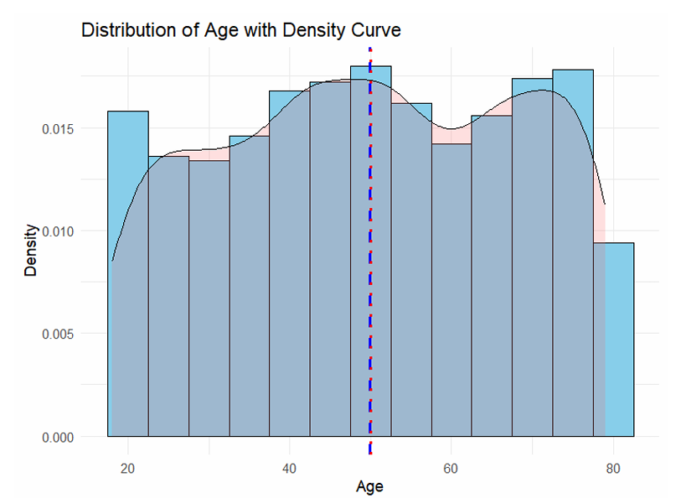
Obesity Classification Dataset
Data Analysis:
This figure shows the study's age distribution primarily centers on middle age groups, with two peaks and fewer older participants, as illustrated by a histogram and density plot.
Distribution of Age with Density Curve

Slide 14
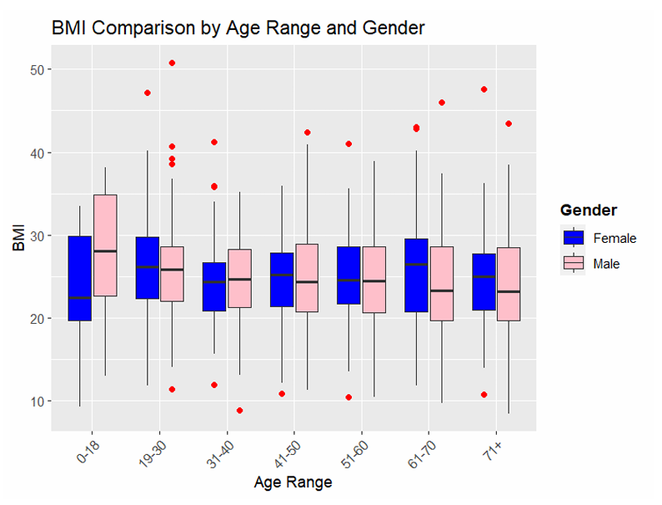
Obesity Classification Dataset
Data Analysis:
This figure compares BMI distributions by gender across seven age ranges, showing consistent median BMI between genders with a slight increase in older ages and a broad spread within categories indicating diverse BMI values and outliers.
BMI Comparison by Age Range and Gender

Slide 15
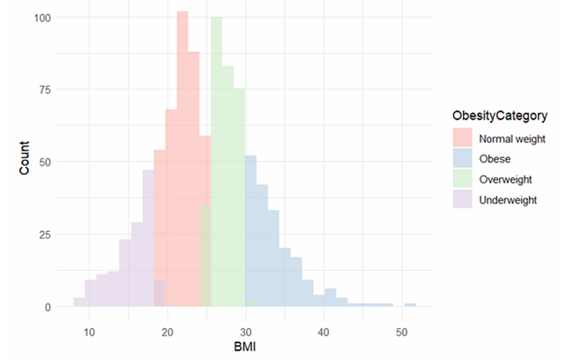
Obesity Classification Dataset
Data Analysis:
This figure’s histogram shows distinct peaks for each obesity category, despite some overlap between 'Normal weight' and 'Overweight,' clearly visualizing the distribution of BMI within the dataset and highlighting the differences between obesity classifications.
BMI Distribution by Obesity Category

Slide 16
03
Classification Model

Slide 17
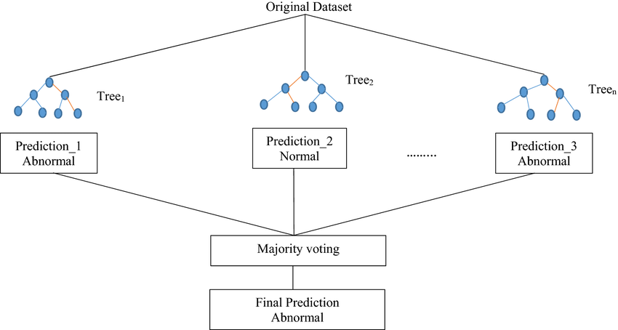
Classification Model
Model Architecture
Random Forest Classifier

Slide 18
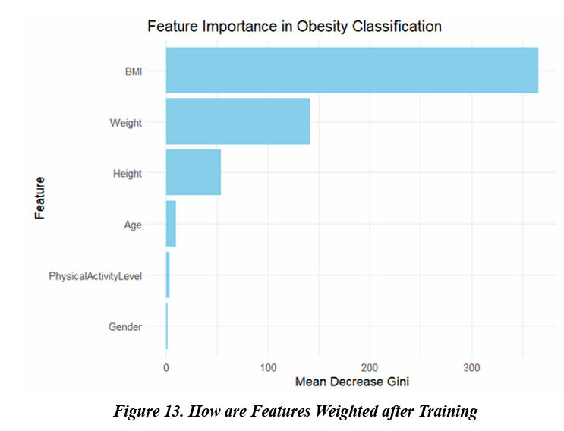
Classification Model
Feature Importance
The 'BMI' feature has the highest mean decrease, which indicates that it is the most significant predictor of obesity in the model, followed by Weight, Height, Age, Physical Activity Level then Gender respectively

Slide 19
04
Model Evaluation

Slide 20
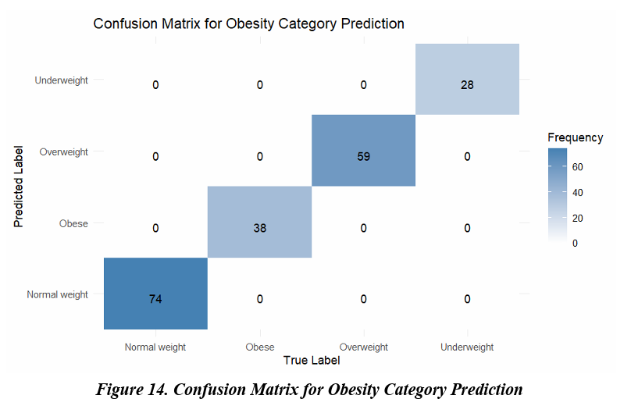
Evaluation
Confusion Matrix
The model has achieved an accuracy of 100%, which is quite remarkable.
This means that all of the predictions made by the model align with the actual data.

Slide 21
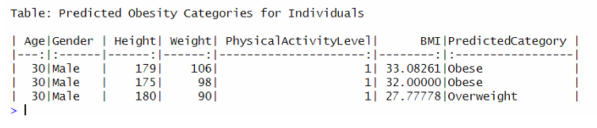
Evaluation
So except for Mr. Quan (SA) with the height of 180cm and 90kg in weight is categorized as Overweight….

Slide 22



Evaluation
Mr. ThanhNX
Mr. Quan (SA)
Height = 179 cm; Weight = 106 Kg
Height = 175 cm; Weight = 98 Kg

Slide 23
05
Conclusion

Slide 24
Conslusion
Global and Vietnam obesity rates from 1975 to 2016 show an alarming upward trend, underscoring the impact of fast food and sedentary lifestyles.
Analysis reveals significant obesity rate trends across demographics, suggesting the necessity for customized health interventions and policies.
A computational model on teachers' obesity patterns highlights the complex interplay of lifestyle choices and environmental factors in obesity.
The findings advocate for educational campaigns, systemic changes for healthier living, and the use of predictive modeling to support at-risk groups.

